Slide 1
Health care Insurance
File created on: 8/24/2023 7:05:56 PM

Slide 2
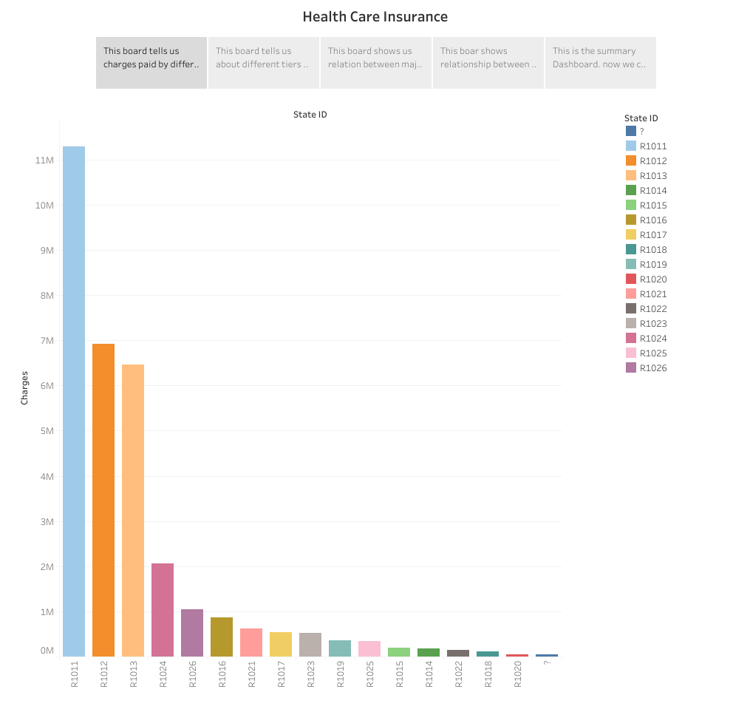

Slide 3
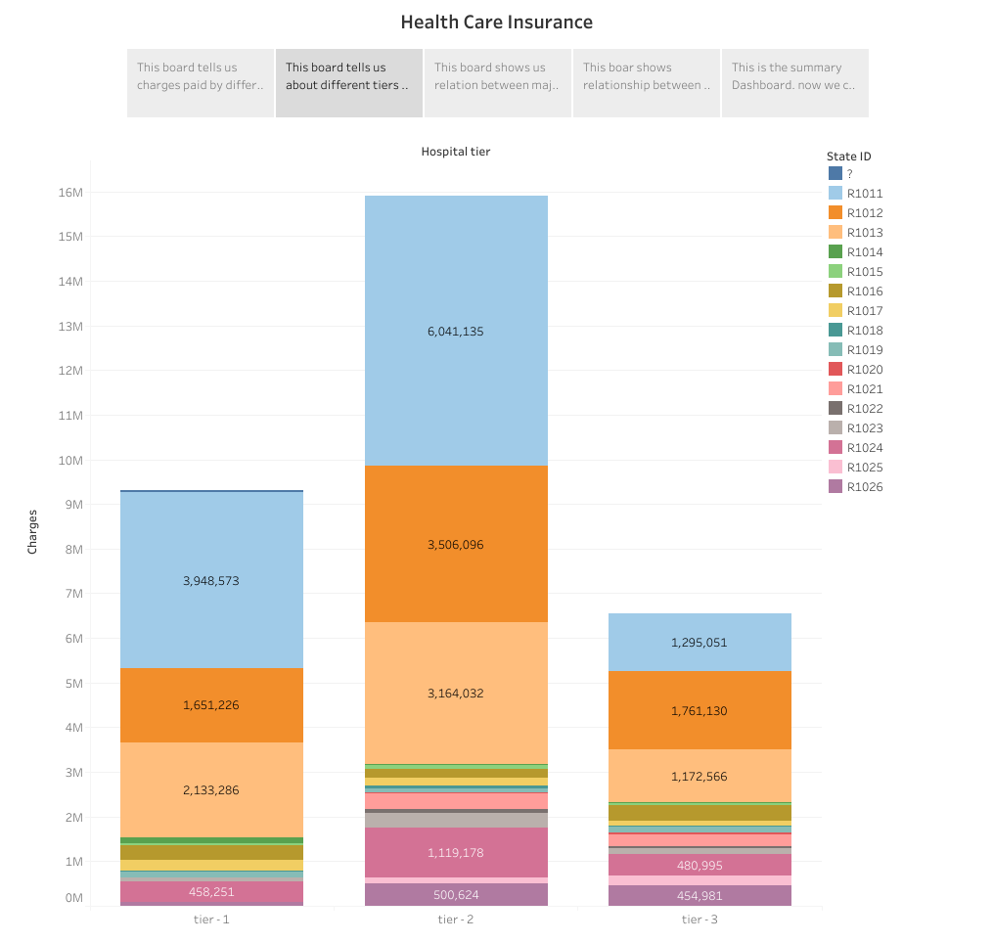

Slide 4
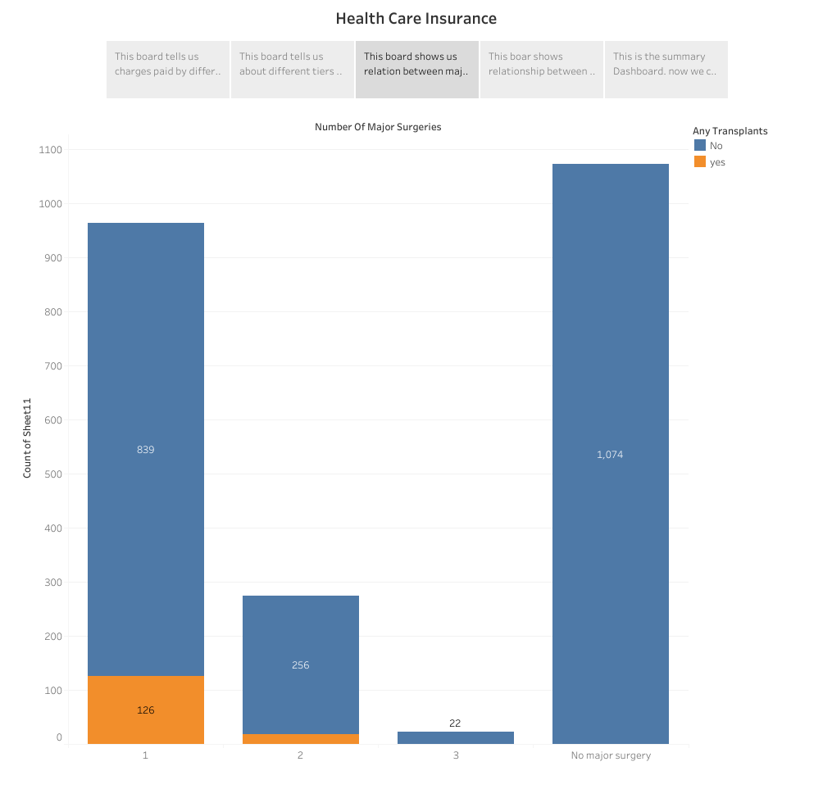

Slide 5
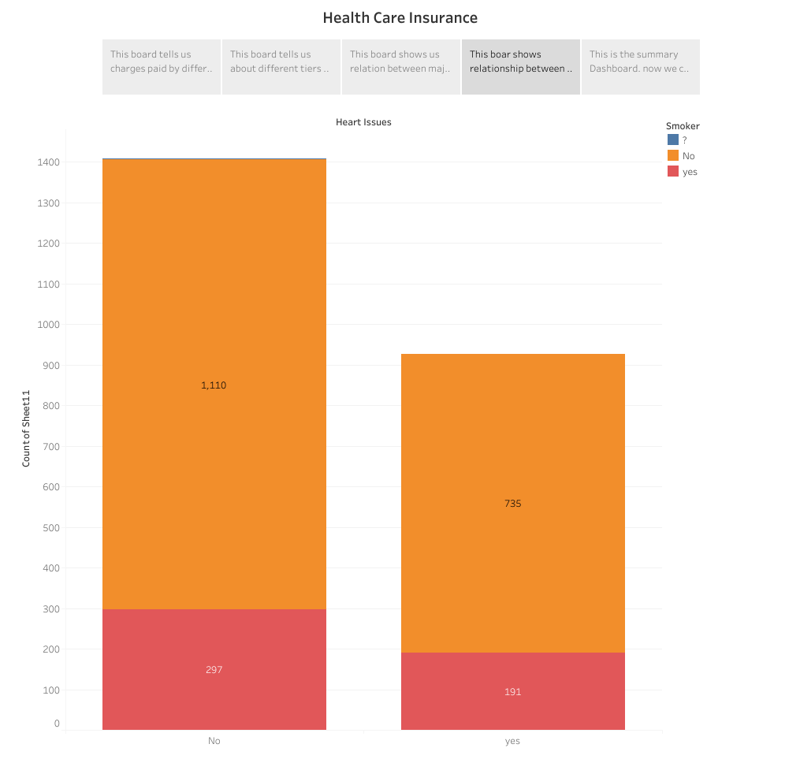

Slide 6
